Slide 1
Box Platform Developer Workshop
Jonathan LeBlanc
Director of Developer Advocacy, Box
Twitter: @jcleblanc
Github: https://github.com/jcleblanc

Slide 2
What are we looking at today?
Box platform use cases
User types, application auth types, and scopes
Service accounts
Collaboration and permissions structures
Error conditions and program flow
Webhooks
Token management and UI tools
Advanced automation and machine learning

Slide 3
Box Platform Common Use Cases

Slide 4







Prerequisite Box Platform Knowledge
User / Account Types
Auth Systems
App User
OAuth 2
Managed User
JWT/OAuth 2
External User
Developer Token
Service Account

Slide 5
Pattern 1: Classic User Model (Vault portals, doc submission, field worker apps)

Slide 6
Classic User Model
Application needs to handle internal and external users
External: App Users
Internal: Managed Users
Content: Owned by App or Managed Users
Description: External end users of the application are App users and the internal audience are Managed Users.
Benefits:
Allows you to provide a custom experience for end users.
No need to build additional functionality for internal users, they can use the Box web application.
The App user model allows you to interact with end user accounts in a headless manner. This means you can bring your own identity system (e.g. Auth0 / Netlify) and map the ids.
API actions taken on behalf of users are recorded in the event stream, meaning that user events can be stored, connected to other systems, and retained for compliance.

Slide 7
Pattern 2: App User Model (Vault portals, doc submission, field worker apps)

Slide 8
App User Model
Application needs to handle internal and external users
External: App Users
Internal: App Users
Content: Owned by App Users (Internal and External)
Description: Much like the classic user model, but all users (internal and external) are App users.
Benefits:
Allows the creation of custom experiences for both internal and external users.
Good for instances where the Box web app is too permissive. This guards internal behavior.
Segmentation of content for managed accounts. This can allow a managed user to have application specific content through an App user account as well.
The App user model allows you to interact with end user accounts in a headless manner. This means you can bring your own identity system (e.g. Auth0 / Netlify) and map the ids.
API actions taken on behalf of users are recorded in the event stream, meaning that user events can be stored, connected to other systems, and retained for compliance.

Slide 9
Pattern 3: Service Account Model (When existing user object models already exists)

Slide 10
Service Account Model
Application needs to handle internal and external users, but a user object already exists
External: Managed by Customer’s Application
Internal: Managed Users
Content: Owned by Service Account
Description: Best used when a company user model already exists, or if you have users that are transient in nature with content that needs to be persistent.
Benefits:
Useful when our app user model will complicate existing applications.
Useful in instances where there is not a good 1:1 end user / app user mapping, such as if end users are mapped as groups.
When the idea of folders don’t fit perfectly with the permission model the customer desires.
Can implement the Box token exchange model to ensure that broad scoped access to the service account doesn’t occur.

Slide 11
Pattern 4: System to System Model (Back office apps and integrations, content ingestion)

Slide 12
System to System Model
No user content needs to be handled
External: N/A
Internal: N/A
Content: Owned by Service Account
Description: Service accounts are used here as the de-facto user object for system to system interactions and back office workflows.
Benefits:
Perfect for apps where a user construct isn’t needed (e.g. departmental or company owned content that transcends user ownership).
Service account auth is cleanly handled by the JWT process.
Because a service account can be granted elevated scopes, this model allows you to tightly control what activities that the service account can perform. This gives you complete control of assigning permissions to different backend services.

Slide 13
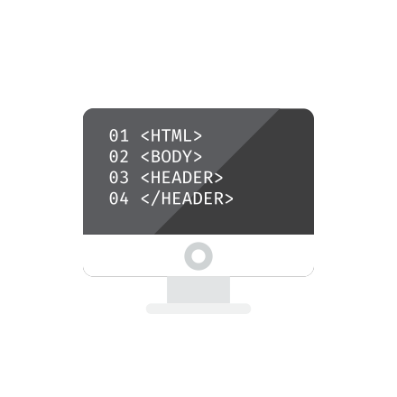
Audience Exercise
Creating your first application on Box Platform
Explore the developer site and console.
Create your first JWT / OAuth application.
Authenticate the application in your enterprise.

Slide 14
User Types, Application Auth Types, and Scopes

Slide 15
Users Types

Slide 16
Types of Users Defined within Box
App User
Managed User
External User
Users created by an app that may only be accessed by that app. This user account can only be accessed through API calls.
A regular Box user that is part of the same enterprise as the app. This user account can be accessed by the API or by logging in to box.com
Same as a managed user, but is not part of the same enterprise as the app. These are users that have been collaborated into content by a user in the enterprise.

Slide 17
Application Auth Types

Slide 18
Types of Auth Systems Box Platform Employs
OAuth 2
JWT / OAuth 2
Developer Token
Use a user’s Box login as the identity system
Use an existing identity system without logging into Box
Short lived developer prototyping token

Slide 19
OAuth 2
User types: Managed users.
Requires that users be forwarded to Box to log in with their Box account to accept app permissions.
Access token that is generated is bound to the user who logged in.

Slide 20

JWT / OAuth 2
User types: Managed and app users.
Allows the use of an existing identity management system.
Allows the app to manage all user and config content.
Runs behind the scenes.

Slide 21
Developer Token
User types: None.
Short lived (1 hour) token generated in the application config.
Cannot be refreshed programmatically, only manually.
Should only be used for quick testing & API requests, never in production.

Slide 22
Scopes

Slide 23
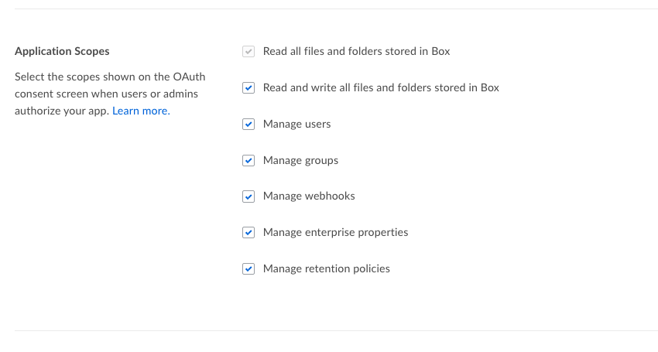
Application Scopes
What your application will have permission to do on behalf of the application, enterprise, and users.

Slide 24
Read / Write Files & Folders
Upload / View / Download files and folders, and update file versions.
Create / Read / Update / Delete collaborations, tags, tasks, comments, @mentions, task assignments, notifications, and collections.
View enterprise profile information.

Slide 25
Manage Users
Create / Read / Update / Delete / Activate / Disable Users (app and managed).
Change primary login, reset password, change role for managed users and enterprise content.

Slide 26
Manage Groups
Create / Read / Update / Delete groups and group memberships for users.

Slide 27
Manage Webhooks
App can programmatically control webhooks (referred to as webhooks v2).
Create / Read / Update / Delete new or existing webhooks on files and folders.

Slide 28
Manage Enterprise Properties
Read / Update enterprise attributes and reports.
Edit / Delete device pinners (what devices can use native Box applications).

Slide 29
Manage Retention Policies
Create / Read / Update data retention policies.
Feature is tied to Box Governance service package.

Slide 30
Audience Exercise
Set up the Box SDK, authenticate, and make your first content call
Download and setup the Box SDK in your preferred language.
Authenticate with the SDK to get a valid client / access token.
Create your first app user.
Stretch goal: Create a managed user with a valid email and log in to Box with their credentials.

Slide 31
Links and Code Samples

Slide 32
Code Samples
Authentication and Authorization (JWT / OAuth2)
Creating a JWT app client with the downloaded Box application config file https://github.com/jcleblanc/box-workshops/blob/master/app-auth/jwt-auth-config.js
Creating a JWT app client with manually created public/private keys: https://github.com/jcleblanc/box-workshops/blob/master/app-auth/jwt-auth-keys.js
Manually constructing the JWT claims process (no SDK): https://github.com/jcleblanc/box-examples/blob/master/node/samples/auth_jwt_api.js

Slide 33
Code Samples
User Management
Create a new app user: https://github.com/jcleblanc/box-workshops/blob/master/app-auth/create-app-user.js
Create a new managed user: https://github.com/jcleblanc/box-workshops/blob/master/app-auth/create-managed-user.js
Delete a user by ID: https://github.com/jcleblanc/box-workshops/blob/master/app-auth/delete-user.js

Slide 34
Service Accounts

Slide 35
What is a Service Account

Slide 36

Service Account Details
A user account that represents your application in an enterprise.
Can only be accessed programmatically.
Has its own file storage.
Generated automatically with a new JWT application.
Access Rights
By default, a service account only has access to its own data store.
Access to app users / managed users has to be explicitly enabled and requested.

Slide 37
Service Account Architecture

Slide 38

Where to Store User and Application Data
Service Account
User Account
Maintain all user an application
data within the service account.
Users will be collaborated in
on content.
User specific data is maintained
in the individual user account. All
data access requests are made on
behalf of the user.

Slide 39

Storing Data in the Service Account (Overview)
Benefits
Improved data security due to tight controls over data location and sharing
Data retention and migration improves following customer deletion, as the user collaboration is simply removed.
Concerns
Architecture complexity increases as a separate user folder structure needs to be maintained in the service account.
Single point of failure.

Slide 40

Storing Data in the User Account (Overview)
Benefits
Data is retained and owned by each user.
Simple repeatable architecture on each user account.
Concerns
Data retention after customer deletion requires data migration or loss.
App has no control over data integrity.

Slide 41
Users and Permissions

Slide 42



User Access Levels for a Service Account
No User Access
App Users
All Users
Service account can only
access its own content
Service account can access
its own content and content for
any app users it creates
Service account can access
its own content, app user
content, as well as content of any
users in the enterprise

Slide 43
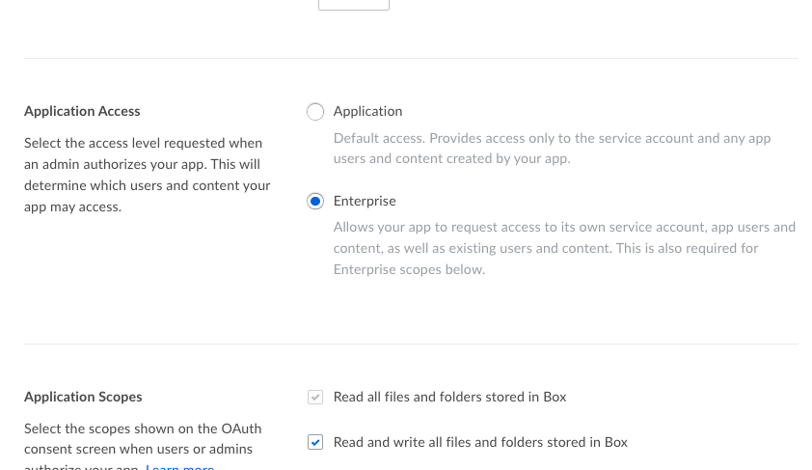
Application Access
Application: Only access data and users within the JWT app.
Enterprise: Access data and users within the app as well as the entire enterprise that the app is a part of.

Slide 44
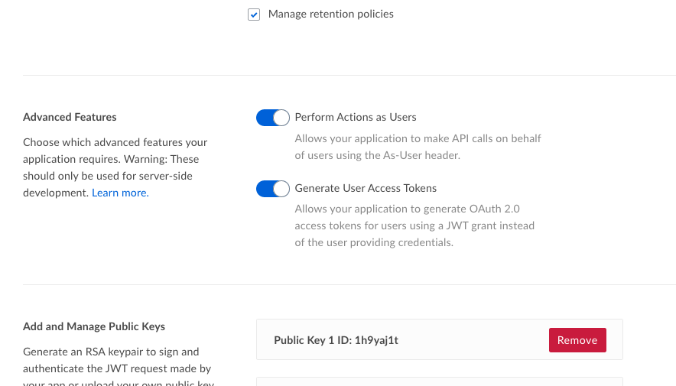
Advanced Features
Perform actions as users: Use an As-User header with each request to act on behalf of a user. Access token passed is for service account.
Generate user access tokens: Create an access token scoped to a user account and use that token for each request.

Slide 45
Setting User Access for the Service Account
Settings to use to get the desired level of user access for a service account
User Access | Application Access | Advanced Features
No User Access | Application | None set
App Users Only | Application | One or both set
App and Managed Users | Enterprise | One or both set

Slide 46
Audience Exercise
Making API calls between the service and user accounts
Using the enterprise client, upload a file to the service account.
Get a user access token using the As-User header or user access token method.
Upload a file to the app user created previously.

Slide 47
Links and Code Samples

Slide 48
Code Samples
Service Accounts
Uploading file to service account: https://github.com/jcleblanc/box-workshops/blob/master/service-accounts/service-account-upload-sa.js
Uploading file to user account using As-User header: https://github.com/jcleblanc/box-workshops/blob/master/service-accounts/service-account-upload-asuser.js
Uploading file to user account using user access token: https://github.com/jcleblanc/box-workshops/blob/master/service-accounts/service-account-upload-usertoken.js

Slide 49
Collaboration and Permissioning

Slide 50
Permission Structure

Slide 51
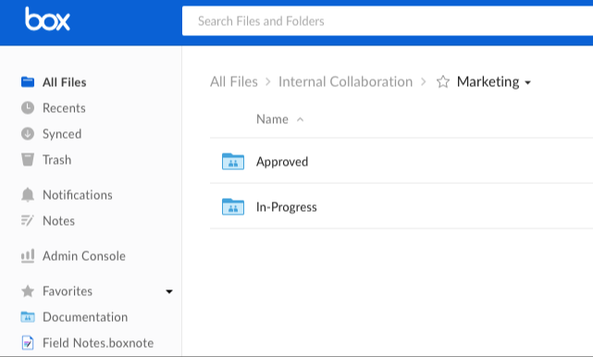
Folder Permission Model
Waterfall permission model for folders
When users are collaborated in on a folder they can view all files / folders under that folder.

Slide 52
Common Folder Models
Duplicate Folders for each User
A folder model is created and duplicated for each user. Collaborators or groups are added at each level.
App User 1
App User 2
Config
Config
User Data
User Data
Personnel
Personnel
Operations
Operations

Slide 53
Common Folder Models
Business Level Ownership
Enterprise Admin
The Box enterprise admin, or appropriate leadership level, would maintain the root folder level.
Each business level is maintained under that level, where major business units may have minor units located underneath.
Marketing
Sales
Products
Parts & Services
Engineering

Slide 54
Collaborations

Slide 55

Collaboration System
Service accounts and users start by only being able to access content in their own accounts.
For those accounts to access content from other accounts they will need to be collaborated in on content.
Users can be collaborated via ID, email, or group ID.

Slide 56
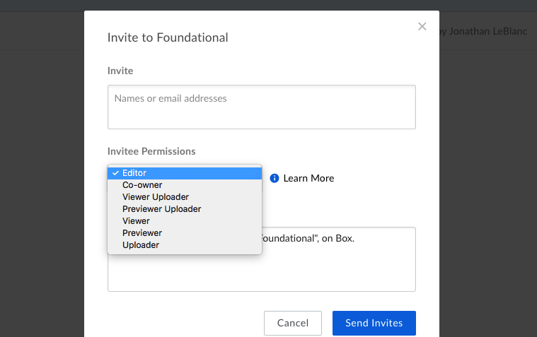
Collaboration Types
co-owner: Full access
editor: Full access minus invites / settings
previewer: Basic view and edit
previewer uploader: Previewer + uploader
uploader: Upload, basic metadata, and view
viewer: Preview + download and send links
viewer uploader: Viewer + uploader
Notes:
Full description of roles: https://community.box.com/t5/Collaborate-By-Inviting-Others/Understanding-Collaborator-Permission-Levels/ta-p/144

Slide 57
Audience Exercise
Making API calls between the service and user accounts
Create a folder in the service account.
Use your existing app user or create a new managed user account.
Collaborate the user in on that folder with editor permissions.

Slide 58
Links and Code Samples

Slide 59
Code Samples
Collaborations and Permissions
Add Collaborators to a Folder: https://github.com/jcleblanc/box-workshops/blob/master/collaboration/collaborate_add.js
Remove a Collaboration: https://github.com/jcleblanc/box-workshops/blob/master/collaboration/collaborate_remove.js

Slide 60
Error Conditions and Program Flow

Slide 61
Access Token Errors (401: unauthorized)

Slide 62
Causes of Unauthorized Errors
Access token maintenance
Access tokens expire after 1 hour. At that point they must be refreshed using the refresh token.
The .Net, Java, and Node SDKs handle this refresh action automatically. For any other SDK or direct API integration token expiration responses (401: unauthorized) will need to be handled through the app.

Slide 63
Scoping Errors (403: access_denied_insufficient_permissions)

Slide 64
Causes of Insufficient Permissions Errors
User and application scoping
There are typically two causes of a 403: access_denied_insufficient_permissions error, either the user an access token is scoped for doesn’t have permission to perform an action, or the application doesn’t.
For user permissions, try logging in as the user via the “Log in as this User” option in the admin console. Attempt to access the content manually.
For an application, ensure that the application has the correct scopes defined for the action that it is trying to perform.

Slide 65
Item Location Errors (404: not_found)

Slide 66
Causes of Not Found Errors
Access Token Scoping
This may be encountered when trying to work with files and folders within Box when using a JWT / OAuth 2 based application with a service account. If the ID of the file / folder that is being accessed has been verified as present, this error will typically be caused by the account that the client is pointing to. For instance, if a file exists on a user account but the access token client is scoped for the service account, then a 404 error may be produced.
In cases of an access token that is scoped to the wrong account, use the As-User header or user scoped access token for user access, or a service account scoped access token for service account files.

Slide 67
Name Conflicts (409: item_name_in_use)

Slide 68
Causes of Name Conflicts
Checking name uniqueness
File / folder names within a given folder must be uniquely named. When there is an attempt to create a new file / folder with a name that already exists, a 409: item_name_in_use, or a standard 409: conflict may be produced.
In case of a duplicate user login information being used when creating new managed users, a 409: user_login_already_used error would be produced.
These errors should be handled. Possible next steps in the program flow would be to attempt the same API request / login with revised information.

Slide 69
Metadata Conflicts (409: tuple_already_exists)

Slide 70
Causes of Metadata Conflicts
Checking if metadata is already present on a file
If metadata for a template is already present within a file and a request to add metadata is made, the API will return a 409: tuple_already_exists error.
This error should be handled in a try / catch. When found, a request to update the existing metadata should then be made.
Update requests will need to use a JSON patch object.

Slide 71
Rate Limits (429: rate_limit_exceeded)

Slide 72
Causes of Rate Limiting
Check Retry-After header for amount of time until next call
Making requests to auth a user each time they visit. Access tokens should be stored for future use.
Polling the event stream too often. Cache results when possible.
Producing too many requests from a single user (e.g. a service account). Limit is 10 API calls per second per user.
Making too many simultaneous upload requests from a single user. Limit is 4 uploads per second per user.

Slide 73
Audience Exercise
Handling 409 name conflict errors properly
Upload a file to the service account with duplicate file name as one that already exists.
Listen for the 409 error code and the name conflict response.
When encountered, retry the file upload with an alternate file name.

Slide 74
Links and Code Samples

Slide 75
Code Samples and Links
Error Conditions
Handling 409 name conflict errors: https://github.com/jcleblanc/box-workshops/blob/master/error-conditions/409-name-conflict.js
Handling 409 metadata conflict errors: https://github.com/jcleblanc/box-workshops/blob/master/error-conditions/409-metadata-conflict.js
Errors codes produced by the Box APIs, and their solutions: https://developer.box.com/docs/error-codes

Slide 76
Webhooks

Slide 77
Webhooks V1

Slide 78
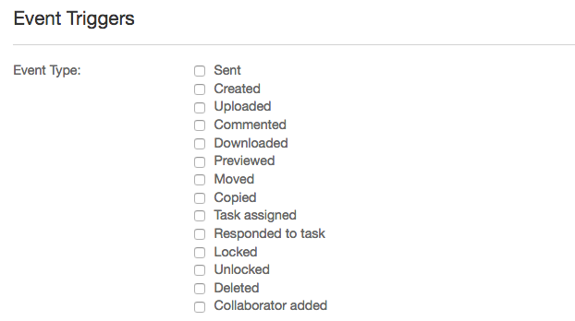
Webhooks V1 Details
Manually created through the app dashboard: https://app.box.com/developers/console
Cannot be adjusted programmatically
Produces webhook events for all actions in an app and cannot be bound to a file / folder.
Notes:
Review webhooks V1 by clicking on your app at https://app.box.com/developers/console then select “Webhooks” from the left menu.

Slide 79
Webhooks V2

Slide 80
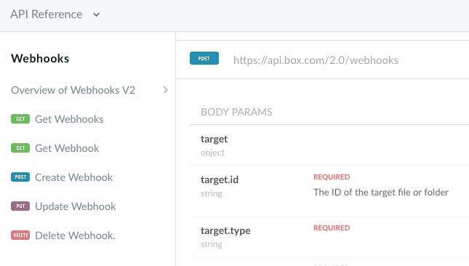
Webhooks V2 Details
Programmatically created and maintained through the Webhooks APIs.
Create, Read, Update, and Delete endpoints.
Can be bound to a single file or folder

Slide 81
User Events
ACCESS_GRANTED
ACCESS_REVOKED
COLLAB_ADD_COLLABORATOR
COLLAB_INVITE_COLLABORATOR
COLLAB_REMOVE_COLLABORATOR
COLLAB_ROLE_CHANGE
COMMENT_CREATE
COMMENT DELETE
ENABLE_TWO_FACTOR_AUTH
GROUP_ADD_USER
GROUP_REMOVE_USER
ITEM_COPY
ITEM_CREATE
ITEM_DOWNLOAD
ITEM_MAKE_CURRENT_VERSION
ITEM_MOVE
ITEM_PREVIEW
ITEM_RENAME
ITEM_SHARED
ITEM_SHARED_CREATE
ITEM_SHARED_UNSHARE
ITEM_SYNC
ITEM_TRASH
ITEM_UNDELETE_VIA_TRASH
ITEM_UNSYNC
ITEM_UPLOAD
LOCK_CREATE
LOCK_DESTROY
MASTER_INVITE_ACCEPT
MASTER_INVITE_REJECT
TAG_ITEM_CREATE
TASK_ASSIGNMENT_CREATE
TASK_CREATE
Notes:
https://developer.box.com/reference#standard-user-events
https://developer.box.com/reference#section-enterprise-events

Slide 82
Audience Exercise
Handling 409 name conflict errors properly
Set up a webhook to listen for file uploads on the service account root folder (ID: 0).
Set the webhook notification URL to send the response to …
Watch for your event on screen.
Notes:
Using webhooks listener (https://github.com/jcleblanc/box-workshops/blob/master/webhooks/webhooks-listener.js) combined with localtunnel: lt --port 3000

Slide 83
Links and Code Samples

Slide 84
Code Samples
Webhooks
Create Webhook: https://github.com/jcleblanc/box-workshops/blob/master/webhooks/webhooks-create.js
Update Webhook: https://github.com/jcleblanc/box-workshops/blob/master/webhooks/webhooks-update.js
Delete Webhook: https://github.com/jcleblanc/box-workshops/blob/master/webhooks/webhooks-delete.js

Slide 85
Token Management and UI Tools

Slide 86
Reducing auth calls by storing access tokens

Slide 87
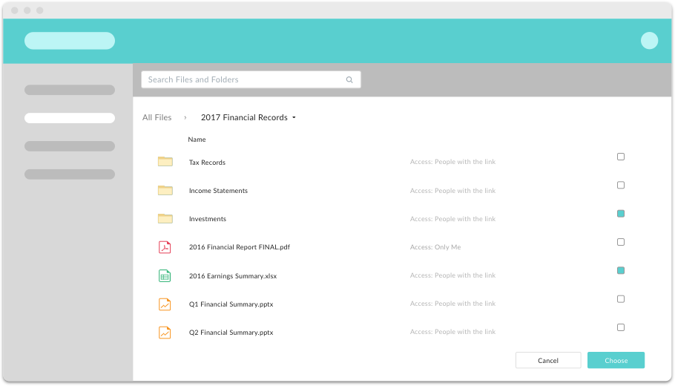
Access Token Best Practices
Access tokens are valid for 1 hour and should be stored / reused.
Tier 1 SDKs (Node, Java, .Net) automatically refresh tokens.
Token expiration (for refresh) should be tracked via expires_in value (from token request) and 401 unauthorized errors.

Slide 88
Downscoping Tokens

Slide 89



Token Downscoping Process
Access Token
Downscoped Token
Client-Side Code
Standard OAuth2 access token that is fully scoped for an enterprise or user.
New access token that is tightly restricted in access rights (read / write) for a file or folder.
Downscoped token is deployed to client-side code, mobile environment, or UI tool.

Slide 90
client.exchangeToken(appConfig.tokenScopes[service]).then((tokenInfo) => {
// token available in tokenInfo.accessToken
}).catch((err) => {
console.error(err);
});
Downscoping a Token (Node SDK)
Notes:
Be careful about load order of the .js file – placing before the div will cause a react-modal error

Slide 91
Item Scopes
item_delete: Delete file/folder.
item_download: Download file / folder.
item_preview: Preview file / folder.
item_rename: Rename file folder.
item_share: Create shared link.
item_upload: Upload new content.

Slide 92
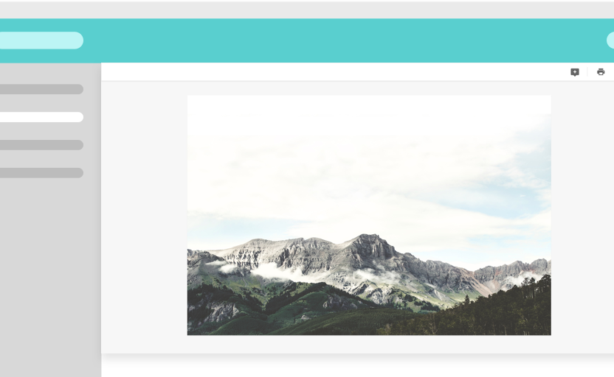
Annotation Scopes
annotation_edit: Update existing annotations on files.
annotation_view_all: View annotations from all users.
annotation_view_self: View annotations from yourself only.

Slide 93
Working with SDK differences

Slide 94
Support Levels for SDKs
Tier 1 (Full API parity): Java, Node, .Net
Tier 2 (Partial API parity): Python, Ruby, CLI
Mobile (Partial API parity): Android, iOS, Mobile UI Kits
Stable (State complete): Salesforce, JavaScript, Chrome

Slide 95
# Define token exchange scopes / params
scopes = 'base_preview item_download'
folder_id = 'FOLDER ID'
resource = 'https://api.box.com/2.0/folders/%s' % folder_id
# Define https request info
access_token = client.auth.authenticate_instance()
headers = {'Authorization': 'Bearer '+access_token}
url = 'https://api.box.com/oauth2/token'
# Set https request post data
data = { "scope": scopes, "resource": resource, "grant_type": "urn:ietf:params:oauth:grant-type:token-exchange", "subject_token": access_token, "subject_token_type": "urn:ietf:params:oauth:token-type:access_token" }
# Make request to perform token exchange
response = requests.post(url, data=data, headers=headers) json = response.json()
Extracting an Access Token and Making a Manual Call (Python)
Notes:
Be careful about load order of the .js file – placing before the div will cause a react-modal error

Slide 96
Box UI Tools

Slide 97
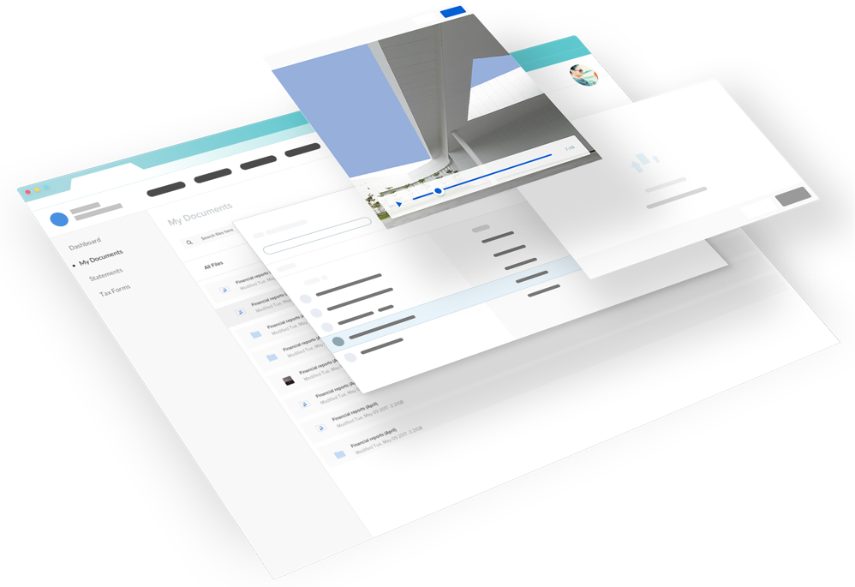
Box UI Elements
UI components build with React (JavaScript library).
Authentication and token agnostic: Works with JWT and OAuth flows.
Use type agnostic: Works with app, managed, and external user types.

Slide 98




Content Explorer
Content Picker
Navigate Box files and folders within your app.
Select Box files and folders within your app
Content Preview
Content Uploader
View docs, images, videos, 3D files, and more within your app
Drag and drop files from a device into your app / Box.

Slide 99
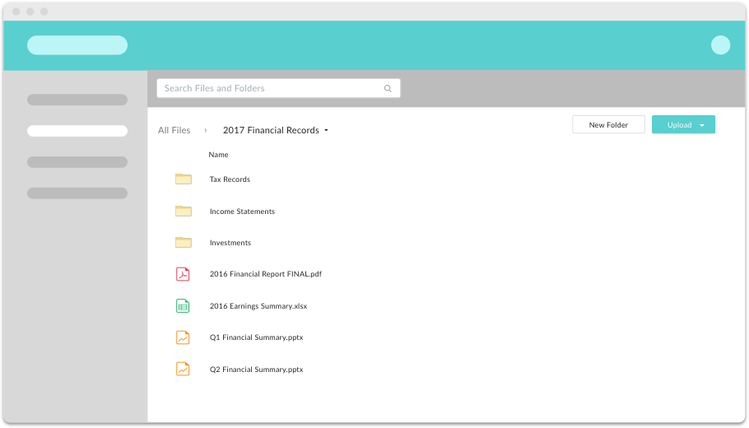
Base Scopes for Token
base_explorer
base_picker
base_preview
base_upload

Slide 100
Audience Exercise
Downscoping tokens for front-end code
Downscope your service account access token for the content explorer element: https://developer.box.com/docs/box-content-explorer#section-scopes
Manually put that in a content picker element for any folder.
Stretch goal: Automatically render the front-end code from the downscoping process.

Slide 101
Links and Code Samples

Slide 102
Code Samples
Token Management and UI Tools
Downscoping tokens: https://github.com/jcleblanc/box-workshops/blob/master/token-management/downscope-token.js
Box Elements (simple content explorer): https://github.com/jcleblanc/box-workshops/blob/master/token-management/box-elements.js
Box Elements (complex example for all Elements) https://github.com/jcleblanc/box-examples/tree/master/node/elements

Slide 103
Advanced Automation and Machine Learning

Slide 104
Skills

Slide 105


Foundational Skills
Custom Skills
Turned on manually through
Box site account. Provides enhancements for images,
video, audio, etc.
Extends upon the platform event pump / webhook system to hook to machine learning system with the intent of enhancing file metadata.

Slide 106
Custom Skills

Slide 107
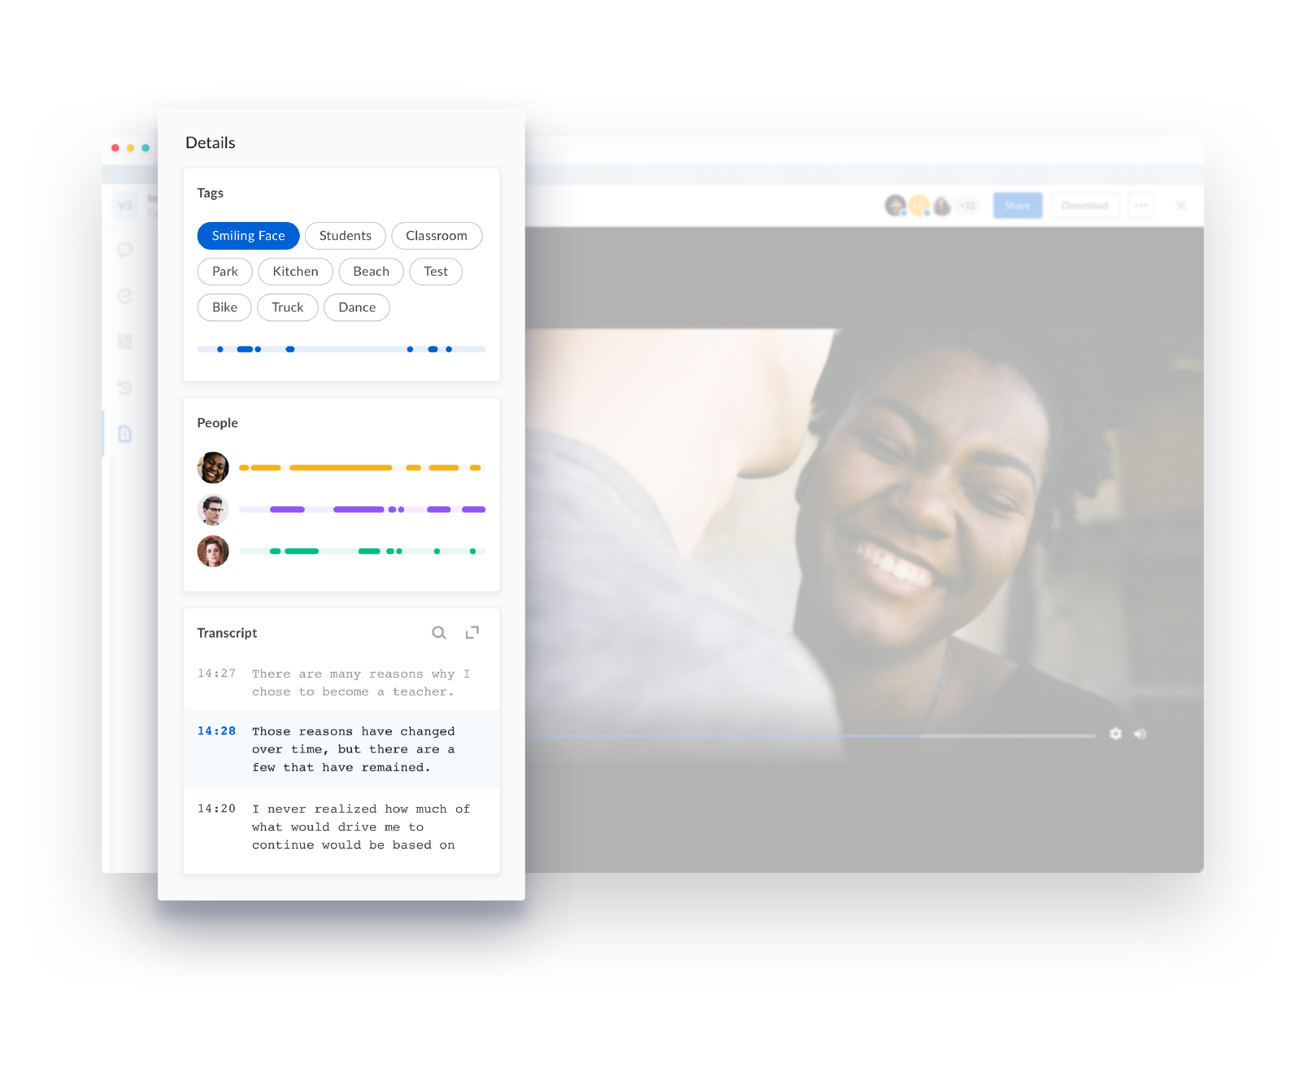
Custom Skills
Allows for the enhancement of file metadata automatically through machine learning services.
Provides multiple card types for displaying data (timeline, transcript, keyword).
Uses tightly scoped read / write downscoped tokens.

Slide 108
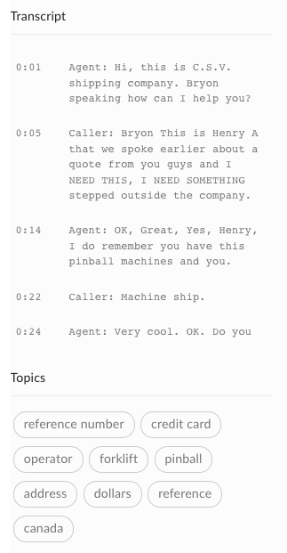
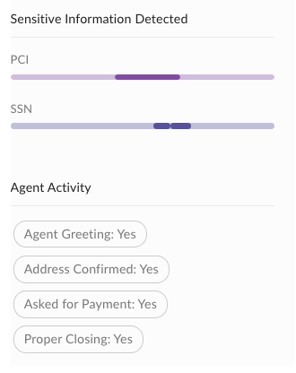
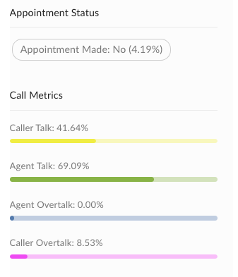
Example Skills Metadata Enhancement (Audio Data)

Slide 109
Skills Workflow
Event
Execute
Metadata
Callback
File Upload
Middleware
Machine Learning
The skills process is triggered when a new or updated file is uploaded to Box. An event is sent to a specified endpoint with file access information.
The middleware layer works as an intermediary between the Box file and ML system. It sends the file info the the ML system and updates the Box file metadata with its response.
The machine learning system will take in the contents of a Box file, run analysis of the data, and respond with the enhanced metadata to the middleware layer.

Slide 110
Audience Exercise
Creating and Updating Metadata
Using a folder or file ID, add new metadata to a file.
Stretch goal: Listen for potential error responses to adding metadata when already present (tuple_already_exists) and update metadata with new values.
Notes:
Using webhooks listener (https://github.com/jcleblanc/box-workshops/blob/master/webhooks/webhooks-listener.js) combined with localtunnel: lt --port 3000

Slide 111
Sample Application

Slide 112
Box Platform Developer Workshop
Jonathan LeBlanc
Director of Developer Advocacy, Box
Twitter: @jcleblanc
Github: https://github.com/jcleblanc

